Slide 1

Title
Earthquake Magnitude Prediction and Visualization Using Machine Learning: A Comprehensive Analysis and Dashboard Implementation
Presented by:
Name : MD. Ashik Afroj
Department of Geology and Mining
Date: 12/12/2024

Slide 2
INTRODUCTION
Objective:
Predict the magnitude of earthquakes and identify high risk zone using machine learning.
Develop an interactive dashboard to visualize seismic trends and make predictions in real-time.
Outcome:
An API for real-time earthquake magnitude prediction.
An interactive web-based dashboard showing earthquake trends and visualizations.

Slide 3
Problem Statement
The Challenge:
Earthquake prediction remains difficult, but estimating magnitude and trends can help mitigate risks.
Goal:
Develop a system that predicts earthquake magnitudes using historical data and allows real-time predictions.
Why it Matters:
Earthquake prediction can aid in disaster preparedness, especially for earthquake-prone regions.

Slide 4
Dataset Overview
Source:
Publicly available earthquake data from https://earthexplorer.usgs.gov/
Dataset is in CSV formate
Key Features:
Latitude, Longitude (Geospatial data)
Depth, Magnitude (Target variable)
Date (Temporal data)
Data Characteristics:
Missing values handled using imputation.
Irrelevant features removed (IDs, status, type).
Size: The dataset contains earthquake data from 01-01-1950 to 19-11-2024 of all the entire earth. The dataset contains 286946 rows and 22 columns.

Slide 5
Data Preprocessing
Handling Missing Data:
Imputation of missing values in columns: depth, magType, nst, gap, dmin, rms, horizontalError, depthError, magError, magNst
Feature Engineering:
Extracted temporal features (year, month, day) from the date.
Encoded categorical variables (magType) into numeric values.
Normalization/Scaling:
Scaled geospatial data (latitude, longitude) and numerical features (magnitude, depth) for model compatibility.

Slide 6
Exploratory Data Analysis (EDA)
Trends Visualized:
Earthquake counts per month and year.
Geospatial heatmap of earthquake locations by magnitude.
Distribution of latitude, longitude, depth, and magnitude.
Visual Insights:
High seismic activity near tectonic plate boundaries.
Magnitude distribution: Most earthquakes fall within a moderate magnitude range.

Slide 7
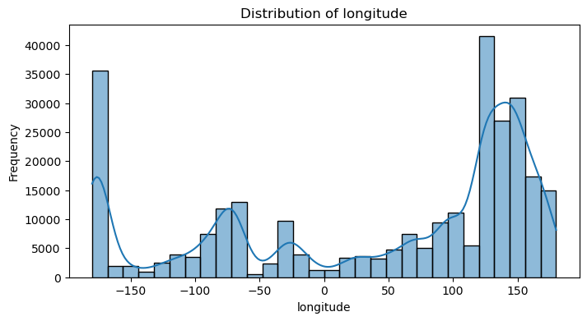
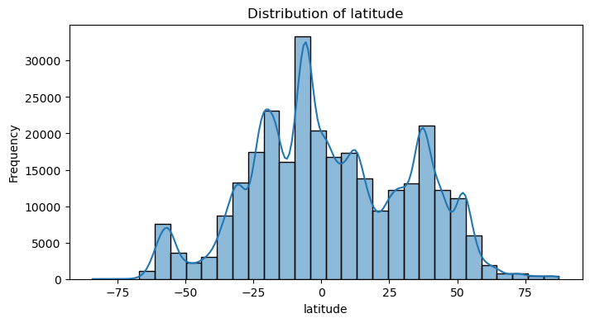
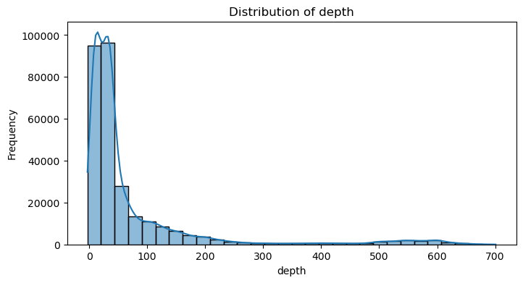
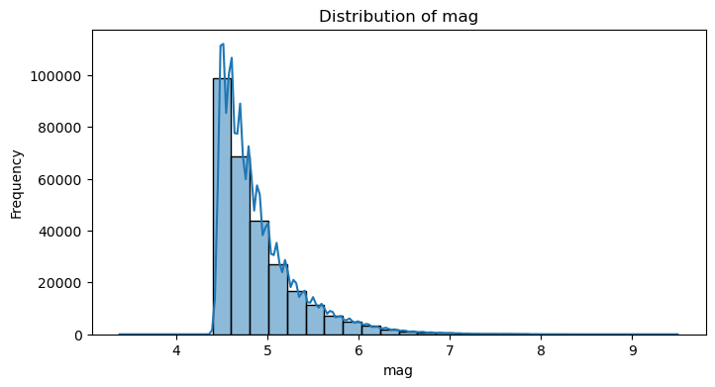
Exploratory Data Analysis (EDA)

Slide 8
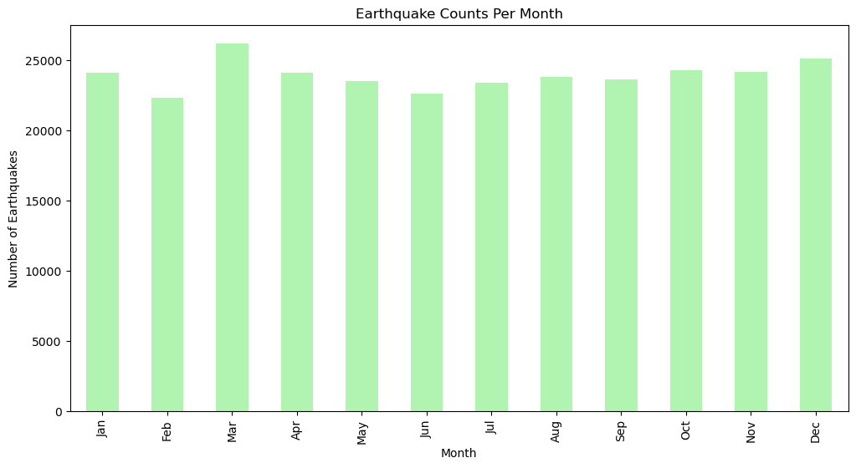
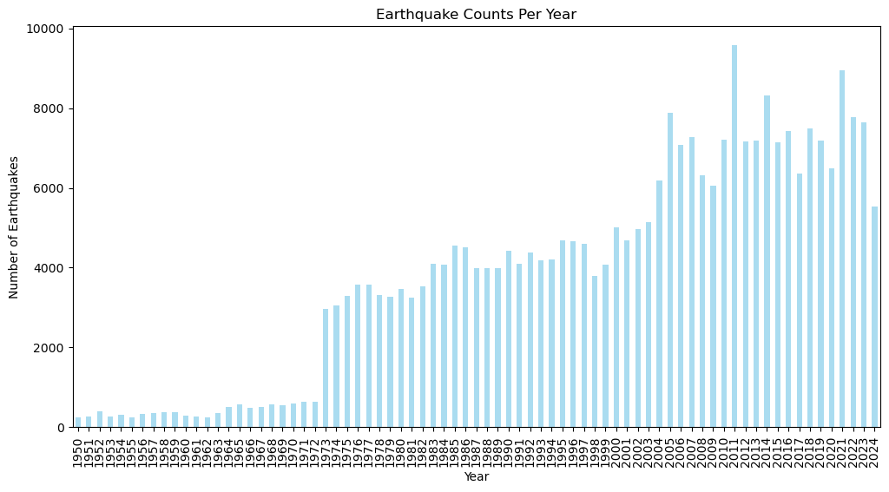
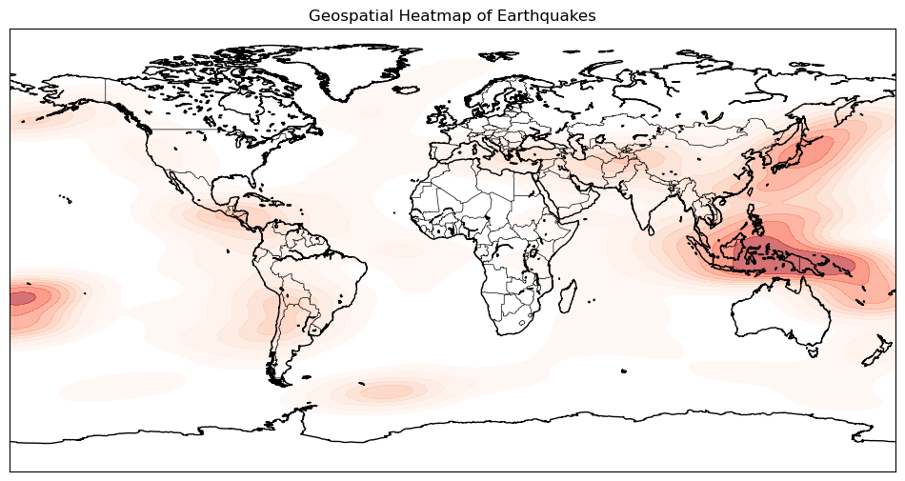
Exploratory Data Analysis (EDA)

Slide 9
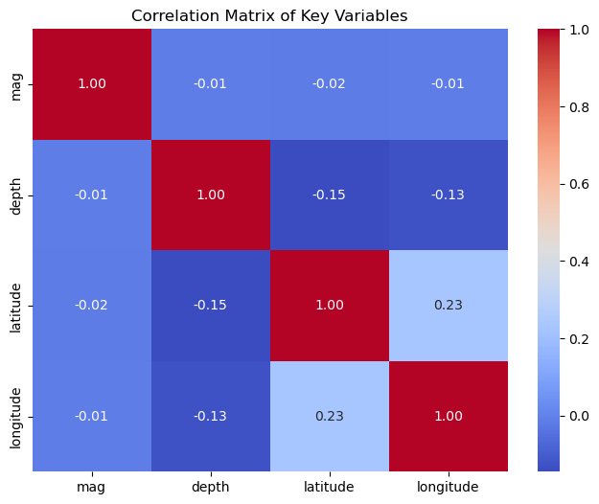
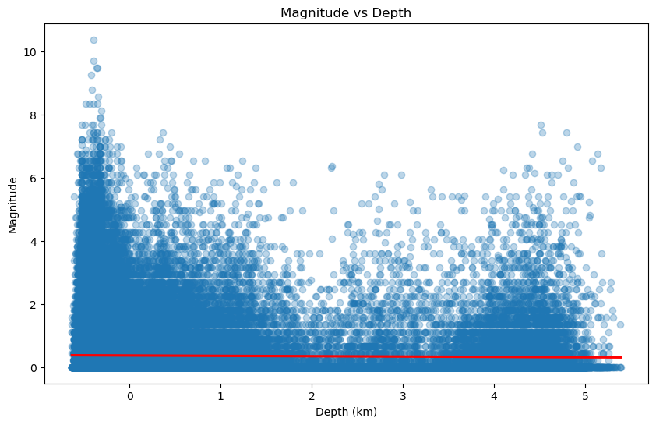
Exploratory Data Analysis (EDA)

Slide 10
Machine Learning Models
Objective: Predict earthquake magnitude (target variable).
Algorithms Used:
Linear Regression (baseline model).
Random Forest (best performing model).
Gradient Boosting (XGBoost).
Model Evaluation:
Mean Absolute Error (MAE) and Root Mean Squared Error (RMSE).
Best model: Random Forest and XGBoost.
Accuracy:
Highlight the performance metrics, e.g., RMSE or MAE for each model.

Slide 11
Clustering Analysis
Geospatial Clustering:
K-means and DBSCAN were used to identify high seismic risk areas.
Clusters were mapped to reveal geographic patterns of seismic activity.
Findings:
Areas near tectonic plate boundaries showed higher clustering of earthquake events.

Slide 12
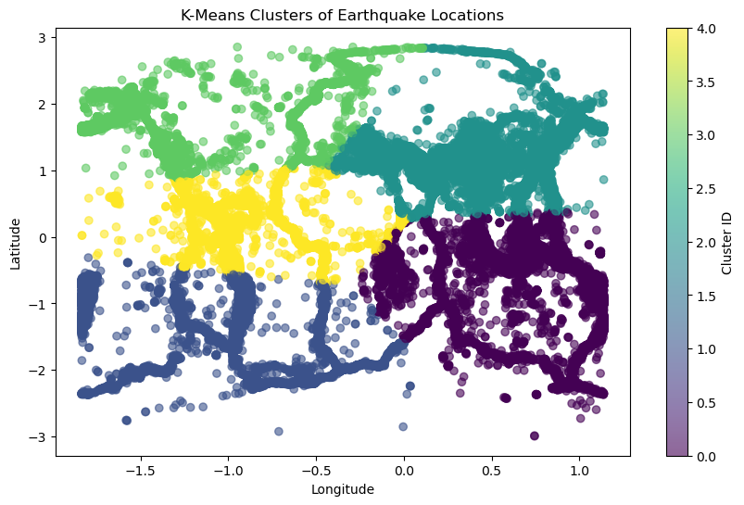
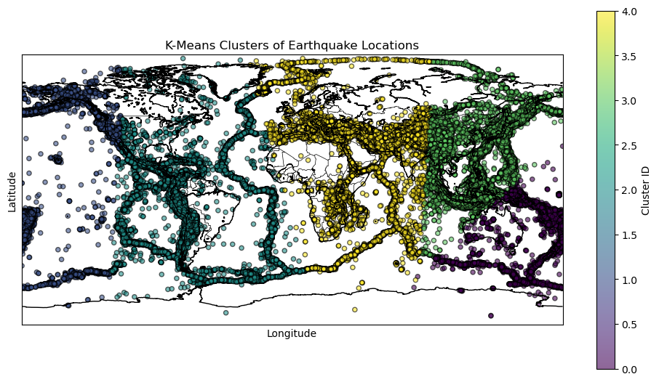
Clustering Analysis

Slide 13
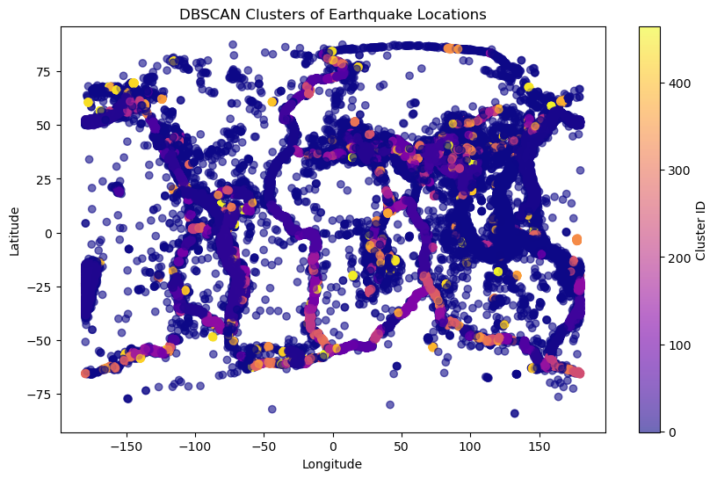
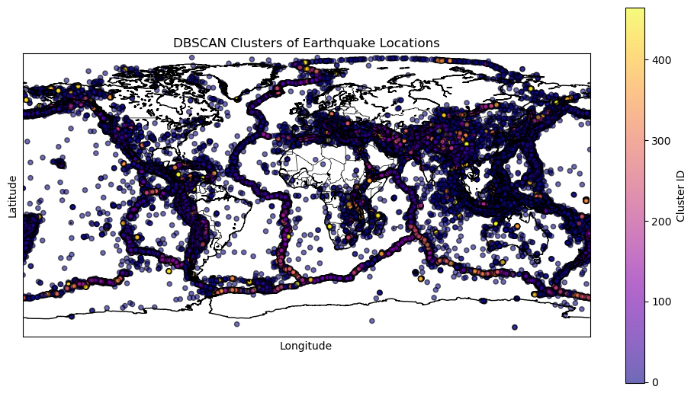
Clustering Analysis

Slide 14
Clustering Analysis

Slide 15
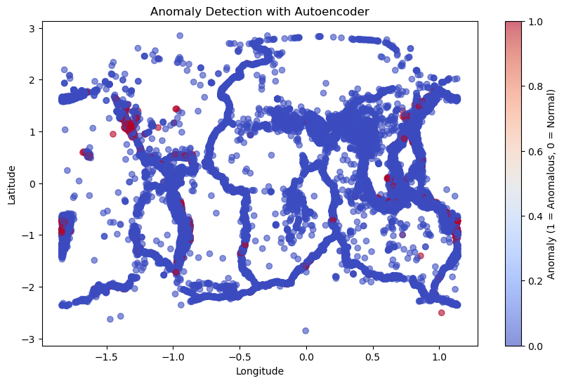
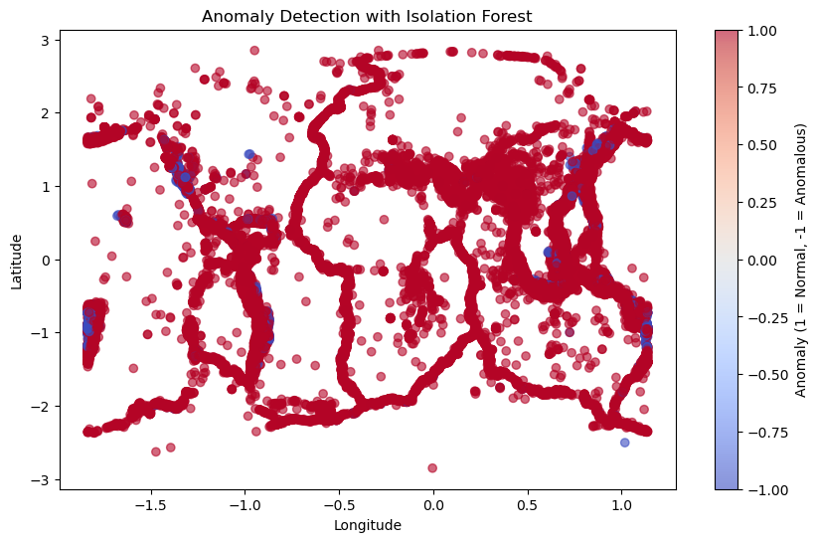
Anomaly Detection

Slide 16
Validation and Evaluation
Evaluating Linear Regression
MAE: 535590.5919
RMSE: 86855656.8922
R2: -42120078674665144.0000
Evaluating Random Forest
MAE: 0.2630
RMSE: 0.4998
R2: 0.5847
Evaluating Gradient Boosting
MAE: 0.2683
RMSE: 0.5088
R2: 0.5695
Model Comparison:
Linear Regression: MAE=535590.5919, RMSE=86855656.8922, R2=-42120078674665144.0000
Random Forest: MAE=0.2630, RMSE=0.4998, R2=0.5847
Gradient Boosting: MAE=0.2683, RMSE=0.5088, R2=0.5695

Slide 17
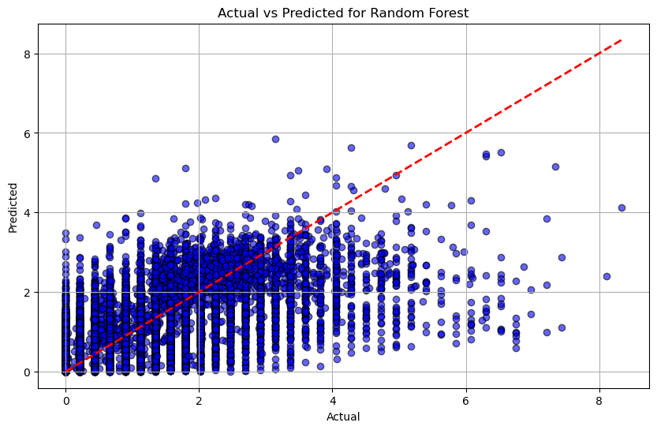
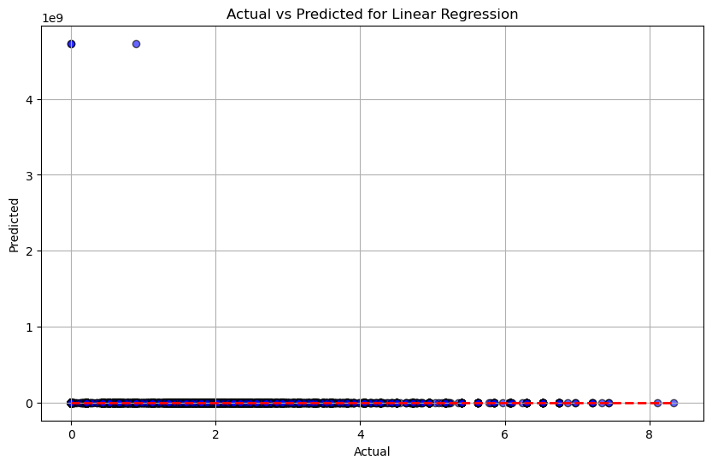
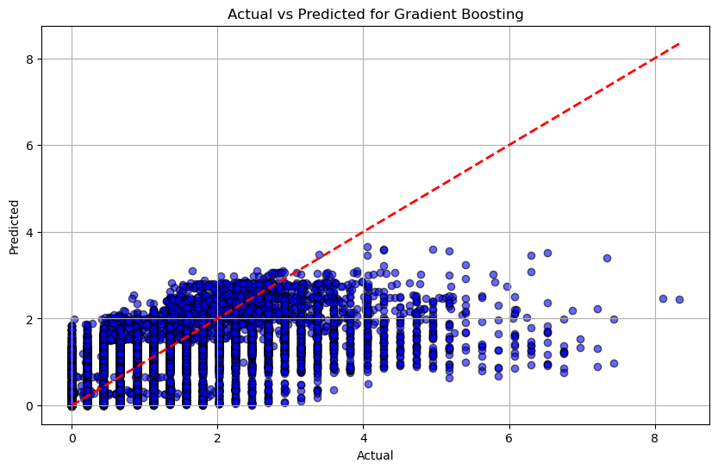
Interpret and Communicate Results
Model: Linear Regression
- Mean Absolute Error (MAE): 247380.6272
- Root Mean Squared Error (RMSE): 34215183.3030
- R² Score: -1964777406083410.5000
Model: Random Forest
- Mean Absolute Error (MAE): 0.2590
- Root Mean Squared Error (RMSE): 0.4956
- R² Score: 0.5878
Model: Gradient Boosting
- Mean Absolute Error (MAE): 0.2654
- Root Mean Squared Error (RMSE): 0.5058
- R² Score: 0.5707

Slide 18
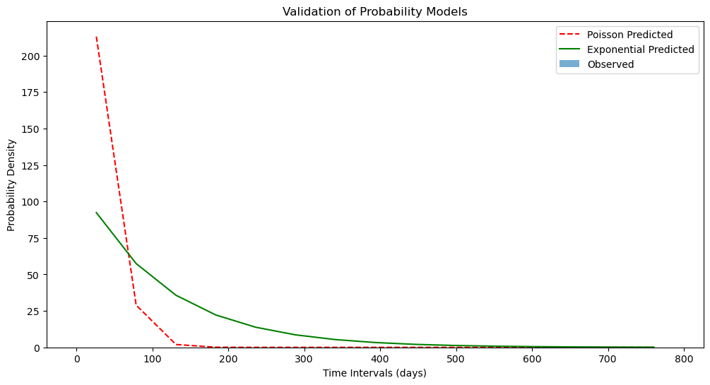
Validate Probability Models
Model Validation Metrics:
Poisson Model - MAE: 16.2656, RMSE: 55.5030
Exponential Model - MAE: 16.2654, RMSE: 30.4399

Slide 19
Develop Risk Maps
Probability Modeling
Estimate Likelihood of High-Magnitude Earthquakes:
Fit statistical models (e.g., Poisson or Exponential distributions) to predict earthquake likelihood in specific regions or timeframes.
Use Bayesian inference for probabilistic estimates.
Temporal Modeling for Future Predictions:
Use time-series forecasting models:
ARIMA for linear trends and seasonality.
Long Short-Term Memory (LSTM) networks for complex patterns.
Develop Risk Maps:
Combine predicted magnitudes and likelihoods with geospatial data.
Use libraries like GeoPandas, Folium to visualize risk zones.

Slide 20
Deployment: Real-time Prediction API
FastAPI Implementation:
A web API deployed to provide real-time earthquake magnitude predictions.
POST Endpoint:
Accepts inputs like latitude, longitude, depth, and date.
Returns predicted earthquake magnitude.
Use Case:
Allows for dynamic earthquake predictions based on real-time data inputs.

Slide 21
Interactive Dashboard
Technology Used:
Dash for interactive visualization.
Dashboard Features:
Magnitude Trend Graph: Displays trends over time.
Geospatial Heatmap: Visualizes earthquake locations.
Prediction Form: Users can input values and receive predicted magnitudes.
Distribution Charts: Show distributions for latitude, longitude, depth, and magnitude.
Demo/Live:
Showcase or link to the dashboard.

Slide 22
Challenges and Solutions
Challenges:
Data Quality: Missing data and inconsistent entries required thorough cleaning.
Model Tuning: Hyperparameter tuning was necessary for improving model performance.
API Integration: Connecting the trained model to the FastAPI framework posed some integration issues.
Solutions:
Handled missing values through imputation.
Applied cross-validation and tuning to improve model accuracy.
Debugged and validated the API for seamless integration.

Slide 23
Results and Outcomes
Prediction Accuracy:
Random Forest and XGBoost were the most accurate in predicting earthquake magnitudes.
Dashboard Insights:
The dashboard provided interactive visualizations, helping users explore seismic trends.
The FastAPI deployment enabled real-time predictions, which could be useful for disaster management.
Impact:
The system provides an easy-to-use tool for predicting earthquake magnitudes and understanding seismic trends, which could be valuable for risk assessment.

Slide 24
Findings
Geospatial Insights:
High seismic activity near tectonic plate boundaries.
Magnitude Distribution:
Most earthquakes occur in the moderate magnitude range.
Model Performance:
The Random Forest model provided the most accurate predictions, followed by XGBoost.
Clustering Patterns:
Earthquake clusters were identified in regions prone to seismic activity, especially near fault lines.

Slide 25
CONCLUSION
Summary:
The project successfully developed a machine learning model to predict earthquake magnitudes and an interactive dashboard to visualize earthquake trends.
Impact:
Provides valuable tools for understanding seismic activity and making informed decisions for disaster preparedness.

Slide 26
Future Work
Model Improvement:
Incorporate additional seismic data for better predictions.
Real-time Integration:
Connect with real-time seismic sensors for up-to-date predictions.
Advanced Visualization:
Enhance the dashboard with more sophisticated analytics tools and predictions.
Collaboration:
Work with disaster management organizations for real-world deployment of the system.

Slide 27
Acknowledgments
Course trainer:
Tools and Libraries:
Python: The primary programming language for all data processing, model building, and visualization tasks.
Pandas: For data manipulation and analysis.
Numpy: For numerical operations and handling large datasets.
Matplotlib: For creating static visualizations such as plots and charts.
Seaborn: For advanced statistical data visualization and creating geospatial heatmaps.
Scikit-learn: For machine learning models including Linear Regression, Random Forest, and Gradient Boosting.
Statsmodels: For statistical modeling, including fitting Poisson regression models.
Geopandas: For handling spatial data and creating GeoDataFrames.
Folium: For creating interactive web maps to visualize earthquake risk zones.
Shapely: For spatial operations, particularly with geospatial data.
DBSCAN and KMeans: Clustering algorithms used for geospatial analysis.
HeatMap from Folium: To visualize the density of earthquakes across different locations.
Md Mahbub E Noor
Lecturer
Dept. of Computer Science and Engineering

Slide 28
Questions
Thank you for your attention and interest in my work.
If you have any questions, clarifications or suggestions please feel free to ask.
I’m open to discussing any aspect of the project in more detail.

Slide 29
THANK YOU
Thank you for your time and attention.
I sincerely appreciate your interest in my research.
Feel free to reach out for further discussions or collaborations.
MD. Ashik Afroj
Email Address: ashik.afroj98@gmail.com
GitHub: https://github.com/Ashik-Afroj/Earthquake_Data_Analysis_Machine_Learning.git

